Slide 1

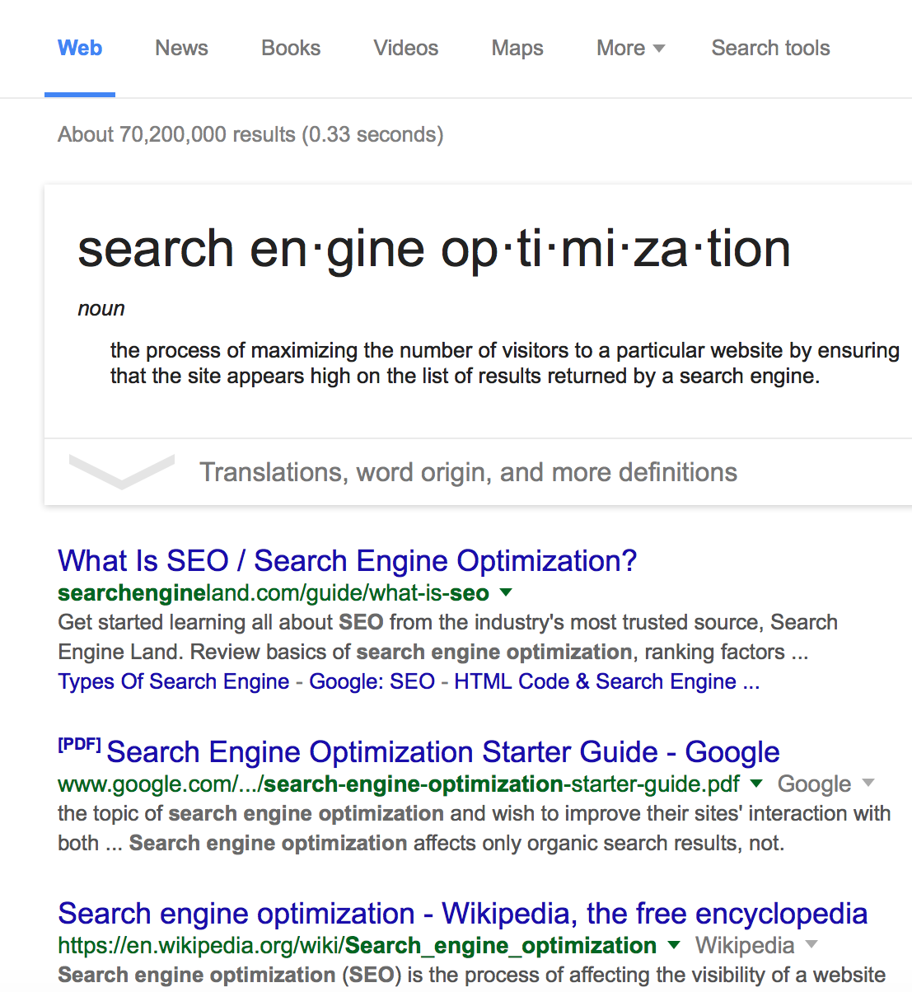
Day
FOUR
Basics of SEO
Webinar Series
Weaving SEO into Your WordPress Service Offering

Slide 2
QUESTION #1
Do You
Like
Puzzles?
Web Savvy Marketing & iThemes Media LLC Copyright © 2015, All Rights Reserved

Slide 3
SEO Puzzles Equal Money
The More SEO Skills You Master the More Money You Can Make
Keywords
Social
Coaching
Web Savvy Marketing & iThemes Media LLC Copyright © 2015, All Rights Reserved

Slide 4
SEO Service Options
Great SEO is More Than Link Building
Keyword research and site mapping
Category and tag strategy
On-page optimization of content and assets
Meta title and description creation
SEO plugin installation and configuration
Webmaster tools management with Google & Bing
Editorial calendar planning and creation
Copywriting
On-going content optimization
Local directory management
Social media management
Ongoing reporting and analysis
One-on-one coaching and training
On-site and remote group boot camps
Technical SEO audits
Content SEO audits
Keywords
Technical
Social
Coaching
Web Savvy Marketing & iThemes Media LLC Copyright © 2015, All Rights Reserved

Slide 5
SEO Service Rates
There’s a Lot of Variation in Service Rates for SEO
Experience and Level of Service Dictate Pricing
Hourly Rates
$75 - $300
Local - Monthly Retainers
$500 - $750
National – Monthly Retainers
$1,000 - $5,000
Project Based Fees
$1,000 - $20,000
SEO Audits
$300 - $3,000
Web Savvy Marketing & iThemes Media LLC Copyright © 2015, All Rights Reserved

Slide 6
Pros of SEO Services
SEO Can Be a Great Addition to a WordPress Consulting Business
Differentiates you from other WordPress developers and consultants
Increases project pricing
Offers a much higher per hourly price point then standard WordPress configurations or coding
Provides an avenue for recurring revenue
Provides diversity in your work
Extends your client base outside of WordPress users
Increases marketing knowledge which in turn helps grow existing WordPress business
Provides a more holistic solution for your clients
Web Savvy Marketing & iThemes Media LLC Copyright © 2015, All Rights Reserved

Slide 7
QUESTION #2
Do You
Like
to Learn?
Web Savvy Marketing & iThemes Media LLC Copyright © 2015, All Rights Reserved

Slide 8
Cons of SEO Services
SEO Can Be a Great Addition to a WordPress Consulting Business
SEO requires lots of education as well as trial and error (to be good)
SEO is very labor intensive
Because SEO is difficult, you can’t just outsource it or delegate it
As soon as you train employees or contractors to perform SEO well, they leave
SEO is constantly changing so ongoing education is a necessity
Google and Bing can shift policies/rules quickly
Because algorithms are tweaked often, you need to be a bit of a mind reader
Some clients do not understand that you cannot have immediate success
Reverse engineering is at the heart of SEO so you have to like this process
Great SEO requires content, so you need active client participation
Web Savvy Marketing & iThemes Media LLC Copyright © 2015, All Rights Reserved

Slide 9
What to Avoid
10 Tips to Keep You Out of Trouble
1
Don’t offer SEO services until you feel confident in your skill-set.
Unlike design, SEO services can have long-term and very damaging effects on clients if performed poorly.
2
Don’t sign up for more SEO services then you can successfully manage.
Start with what you know.
Clients don’t need you to be super hero and expert in all things at once.
They want you to be proficient at the tasks they are paying you to execute.
Web Savvy Marketing & iThemes Media LLC Copyright © 2015, All Rights Reserved

Slide 10
What to Avoid
10 Tips to Keep You Out of Trouble
3
Don’t start with national clients. Instead focus on local small businesses to get your started.
It is much easier to rank local small businesses then it is to rank larger websites that compete at a national or global level..
4
Don’t go horizontal in approach. Instead start with industries you know well.
SEO requires a basic knowledge of the industry terms and intent of the phrases.
If you can’t grasp the content, on-page SEO becomes much more difficult.
Web Savvy Marketing & iThemes Media LLC Copyright © 2015, All Rights Reserved

Slide 11
What to Avoid
10 Tips to Keep You Out of Trouble
5
Don’t sell services clients don’t need. It will discredit you and be challenging to support.
Not every client is going to need a lot of on-going services.
The need for this highly depends on the target market and competition.
6
Don’t promise clients page one status.
Never, ever, ever can you guarantee results.
You simply have way too many variables outside your control to guarantee results.
You cannot control your client or the search engines, therefore you cannot guarantee results.
Web Savvy Marketing & iThemes Media LLC Copyright © 2015, All Rights Reserved

Slide 12
What to Avoid
10 Tips to Keep You Out of Trouble
7
Don’t learn search engine optimization on your client’s dime or website.
You have to invest in your own knowledge and do so on your own time.
8
Don’t set project objectives solely on individual keyword ranking.
SEO success isn’t about how many words rank on page one of Google.
Real SEO success is about new leads, sales, and revenue generation.
Web Savvy Marketing & iThemes Media LLC Copyright © 2015, All Rights Reserved

Slide 13
What to Avoid
10 Tips to Keep You Out of Trouble
9
You can’t fix ugly! Don’t try and optimize a website full of visual, content, or coding issues.
SEO can’t help a broken website or a website with horrendous content.
It simply won’t work so run quickly away from such opportunities.
10
Don’t chase off-site links through outdated link building strategies and techniques.
Instead you should focus on social media, PR outreach, and overall branding.
Those tactics are much safer and far more effective.
Web Savvy Marketing & iThemes Media LLC Copyright © 2015, All Rights Reserved

Slide 14
THE REALITY CHECK OF THIS STATEMENT
“
We have been leveraging Web Savvy’s services for nearly a year now and their results have far exceeded our expectations.
Our total web-site traffic has nearly quadrupled and our revenue has doubled in that period, which we largely attribute to Web Savvy’s web design and SEO results.
I also appreciate their willingness to continuously brainstorm ways to generate additional traffic and integrate our internet and SEO activities with our general marketing initiatives.
Web Savvy Marketing & iThemes Media LLC Copyright © 2015, All Rights Reserved

Slide 15
Boost Your Knowledge
SEMPO
1
SEMPO is the largest nonprofit trade organization in the world serving the search and digital marketing industry and marketing professionals engaged in it.
Read more: http://www.sempo.org
Pricing Guidelines
2
http://www.digitalcurrent.com/seo-engine-optimization/how-much-does-seo-cost/
http://www.sitepoint.com/seo-services/
http://www.websitemagazine.com/content/blogs/posts/archive/2014/11/18/the-average-costs-for-seo-services.aspx
https://www.rankpay.com/seo-services-cost/
Web Savvy Marketing & iThemes Media LLC Copyright © 2015, All Rights Reserved

Slide 16





How Can We Help You?
Cory Miller
Rebecca Gill
@corymiller303
@rebeccagill
Web Savvy Marketing & iThemes Media LLC Copyright © 2015, All Rights Reserved

