Slide 1

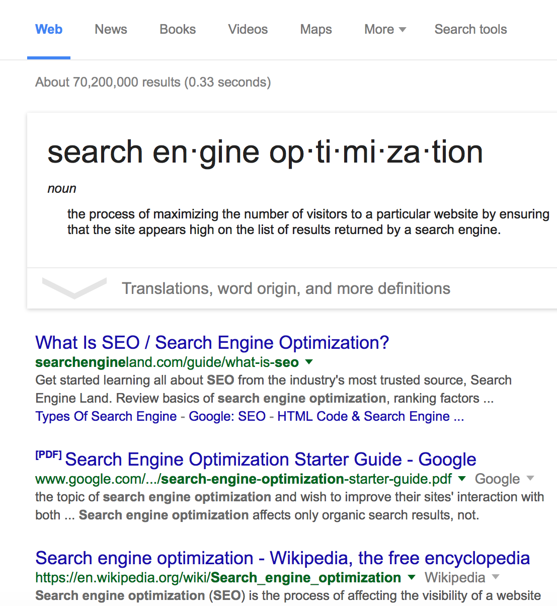
Day
THREE
Basics of SEO
Webinar Series
Driving Success With an SEO Plan, Research, and Focus

Slide 2
RULE #1
Don’t be Greedy
When
Selecting Keywords
Web Savvy Marketing & iThemes Media LLC Copyright © 2015, All Rights Reserved

Slide 3
The Keyword Reseach Formula
Ten Steps to Get Your Brain Focused on Keyword Rich Content
Create list of “seed words” using a variety of sources (we will review that next)
Remove any branded keywords (we don’t optimize for those)
Plug seed word list into Google Adwords tool to obtain search volumes
Extract reports in batches and create one uniform report
Remove unnecessary data columns so you can focus on the right data
Consolidate Google’s multiple reports into one report
Remove duplicate entries
Remove branded keywords (yep we’re doing this again)
Remove keywords that are known to be incorrect (spelling errors)
Remove keywords that seem to be outside your target demographic and market
Web Savvy Marketing & iThemes Media LLC Copyright © 2015, All Rights Reserved

Slide 4
RULE #2
Don’t Rely on Google
to Brainstorm YOUR
Keyword Phrases
Web Savvy Marketing & iThemes Media LLC Copyright © 2015, All Rights Reserved

Slide 5
Brainstorm Keywords
Keywords are Everywhere So Keep Your Eyes Open!
Your Own Ideas
Manual Variations of Initial Search Phrases
Reports, Presentations, Prospect Emails
Google Search Console’s Search Analytics
Google Analytics Reports
Google Adwords Reports
Google Auto Suggest in Search
Google Related Searches
Google Trends
Bing Webmaster Tools
Competitors’ Visual Content
Competitors’ Sitemaps – HTML & XML
Competitors’ Meta Titles and Descriptions
Competitors’ Index Content in Google
SpyFu, semrush, keywordtool.io
Web Savvy Marketing & iThemes Media LLC Copyright © 2015, All Rights Reserved

Slide 6
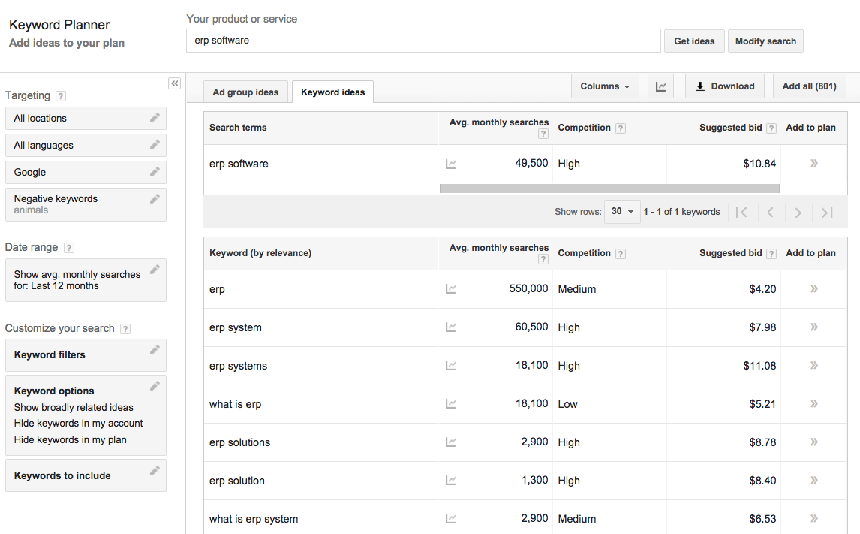
Google Adwords
Keyword Planner
Web Savvy Marketing & iThemes Media LLC Copyright © 2015, All Rights Reserved

Slide 7
The Keyword Reseach Formula
Ten Steps to Get Your Brain Focused on Keyword Rich Content
Create list of “seed words” using a variety of sources (we will review that next)
Remove any branded keywords (we don’t optimize for those)
Import the list into Google Adwords Keyword Planner to obtain search volumes
Extract reports in batches (Google caps the number of phrases displayed)
Remove unnecessary data columns so you can focus on the right data
Consolidate Google’s multiple reports into one report
Remove duplicate entries
Remove branded keywords (yep we’re doing this again)
Remove keywords that are known to be incorrect (spelling errors)
Remove keywords that seem to be outside your target demographic and market
Web Savvy Marketing & iThemes Media LLC Copyright © 2015, All Rights Reserved

Slide 8
RULE #3
Keywords Should
Equal Your Customer’s
Verbiage and Should
Not be Industry Jargon
Web Savvy Marketing & iThemes Media LLC Copyright © 2015, All Rights Reserved

Slide 9
Key Points to Remember
Don’t optimize for branded search terms, because Google already knows this is you.
Don’t optimize for spelling errors, because it degrades your authority with Google.
Zero search volumes isn’t always zero. Google will show this even when we know searches have occurred for actual client websites.
Low volume searches are still good searches, because they:
Make great blog posts
Are easier to rank on in the short term
Help support cornerstone content
Provide options for fresh content.
Web Savvy Marketing & iThemes Media LLC Copyright © 2015, All Rights Reserved

Slide 10
Key Points to Remember
PPC dollar should be reviewed because they help provide insight on search terms that convert into sales. A term with lower search volume and higher PPC amounts is always of interest.
As you work through next steps you want to look at the phrases and think about where we could apply these to actual content:
Cornerstone pages
Supporting pages
Products
Blog posts
Training or resource materials
White papers or eBooks
Web Savvy Marketing & iThemes Media LLC Copyright © 2015, All Rights Reserved

Slide 11
RULE #4
Pick Your Battles!
You Can’t Win Every
Keyword Phrase So
Don’t Waste Time Trying
Web Savvy Marketing & iThemes Media LLC Copyright © 2015, All Rights Reserved

Slide 12
The Site Mapping Formula
Thirteen Steps to Get Your Website Structured
Create a new column in your master keyword spreadsheet for Relevance Score and start assigning a relevance ranking to each keyword:
High – Very relevant to your target market and audience
Medium – Fairly relevant to your target market and audience
Low – Semi relevant to your target market and audience
None
Once done, sort your spreadsheet by relevance so you can see how many phrases apply to each level.
If you have thousands of keywords and/or hundreds of phrases per relevance level, separate them into different tabs so you can focus on one group at a time.
Web Savvy Marketing & iThemes Media LLC Copyright © 2015, All Rights Reserved

Slide 13
The Site Mapping Formula
Thirteen Steps to Get Your Website Structured
Next start with the highest relevance tab and sort this list by keyword.
Create a new column and label it Content URL.
In this new column, assign any existing content to applicable keywords by placing the URL of the content in the appropriate row.
If you have a large site and you’re struggling with the above step, use Google Search Console to locate ranking keywords and content combinations.
Sort your spreadsheet to separate phrases with existing content from those without content.
Now create a new column and label it Focused.
Web Savvy Marketing & iThemes Media LLC Copyright © 2015, All Rights Reserved

Slide 14
The Site Mapping Formula
Thirteen Steps to Get Your Website Structured
Review the list of phrases and determine which ones you’d like to add to your website or blog and mark them in a new column.
Next review this list of focused keywords one by one in Google search to see what lands on page one of SERP. Ask yourself if you can beat content in this list with organic SEO. This step is painful.
Keep phrases you feel confident about as focused phrases in your sheet and remove any you question.
Now assign a new content piece to the focused keywords. Remember these could be pages, posts, products, etc.
Assign higher search volumes to products and pages.
Assign lower search volumes to blog posts.
Web Savvy Marketing & iThemes Media LLC Copyright © 2015, All Rights Reserved

Slide 15
Example Keyword Sheet
Keyword Phrase | Search Traffic | PPC | Relevance Score | Focused | Existing or New | Content Type | Content URL
ERP | 550,000 | $4.20 | High | No | n/a | n/a | mywebsite.com/erp-software/
ERP Software | 49,500 | $10.84 | High | Yes | Existing | Page
ERP System | 60,500 | $7.98 | High | No | n/a | n/a
ERP Softwares | 1,000 | $6.20 | None | No | n/a | n/a
ERP for Small Business | 480 | $15.76 | Medium | Yes | New | Post | mywebsite.com/blog/erp-for-small-business/
Web Savvy Marketing & iThemes Media LLC Copyright © 2015, All Rights Reserved

Slide 16
RULE #5
Find Your Sweet Spot
and Master it Like No Other
Web Savvy Marketing & iThemes Media LLC Copyright © 2015, All Rights Reserved

Slide 17
Success Through Data
Plan
Brainstorming keywords forces you to take a step back and plan your SEO strategy. If you stop yourself from jumping ahead into content writing, you’ll find greater success with SEO.
Research
Researching keyword volumes, scoring keywords, and assigning content provides a structured method for content creation. When you use data it will help illustrate real opportunities for winning in organic search.
Focus
Mapping your future website to desired keywords and doing so based on existing content, market conditions, and known data will help you stay focused on the content that really matters.
Web Savvy Marketing & iThemes Media LLC Copyright © 2015, All Rights Reserved

Slide 18
IN CASE YOU MISSED IT
Let’s take another look
at the core principles we
discussed on day one.
Web Savvy Marketing & iThemes Media LLC Copyright © 2015, All Rights Reserved

Slide 19
Remember the Formula
The Free SEO Tools are Used in the Entire Optimization Process
#1 –Research Keywords
#6 – Build Social Shares
Audit website, review competitors, research keywords and search volumes.
Share content on Facebook, Twitter, LinkedIn, and Google+.
#2 –Map Keywords to Content
#7 – Build Off-Site Authority
Map your preferred keywords to specific pieces of content within your website.
Get your main URL noticed and mentioned
via external sources to strengthen authority.
#3 – Write Content
#8 – Check Ranking Progress
Write content based on keywords, but stay focused on the user experience.
Give Google time to index and rank the content, then check on your progress.
#4 – Optimize Content
#9 – Optimize Further
Optimize URLs, headers, text, links, meta titles and descriptions for the keyword.
Fix what you missed. We all miss something
and we can always improve efforts.
#5 – Build Internal Links
#10 – Document and Repeat Success
Build internal links to the content via your navigation menu, footer, sidebar, content.
Document what ranked, reverse engineer why, and repeat process on other content.
Web Savvy Marketing & iThemes Media LLC Copyright © 2015, All Rights Reserved

Slide 20
Remember the Keys to Success
Research & Plan
Everything is based on research, data, and planning. Don’t write content until you research and explore possible keywords.
Create and Optimize
Create quality content that is closely tied to your target market and the data discovered with keyword research.
Strengthen Process
The process doesn’t end when content is published. Continue to optimize on and off-page as needed until desired results are obtained.
Web Savvy Marketing & iThemes Media LLC Copyright © 2015, All Rights Reserved

Slide 21





How Can We Help You?
Cory Miller
Rebecca Gill
@corymiller303
@rebeccagill
Web Savvy Marketing & iThemes Media LLC Copyright © 2015, All Rights Reserved

