Slide 1

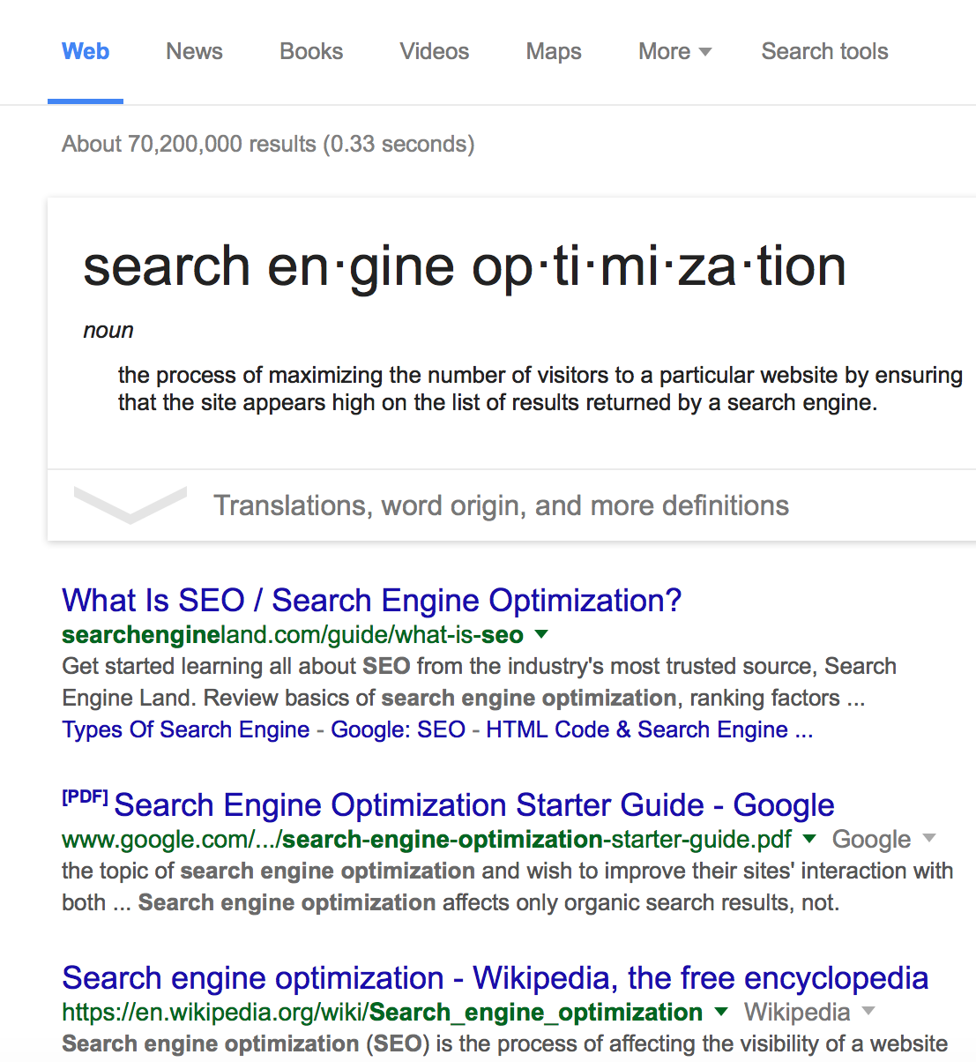
Day
TWO
Basics of SEO
Webinar Series
Free SEO Tools and
How to Use Them

Slide 2
SEO TOOLS ARE EVERYWHERE
But I like to use
tools I’ve tested and trust.
Web Savvy Marketing & iThemes Media LLC Copyright © 2015, All Rights Reserved

Slide 3
Don’t Be Afraid to Dig In!
The best tools are ones that require a little work and investigation by you.
You don’t have to be rich to have great SEO data. You just need to do a little research and investigation on your own.
Web Savvy Marketing & iThemes Media LLC Copyright © 2015, All Rights Reserved

Slide 4
Favorite Tools
PS… They’re all FREE!
Google Analytics
Google Search Console
This shows you what happens on your website – how people arrive and where they leave.
This shows what happens in the Google search page, your ranking, and top pages.
Search Suggestions
Google Adwords
This shows suggestions on associated keyword phrases and how these lead a user in search.
This tools it great for reviewing keyword options and search volumes.
MOZ Toolbar
Yoast Plugin
This is a great tool for easily digging into your competitors SEO efforts.
Good for optimizing content within your WordPress based website or blog.
Web Savvy Marketing & iThemes Media LLC Copyright © 2015, All Rights Reserved

Slide 5
Additional Tools
PS… They’re still FREE!
Google Trends
Alexa
This tool shows Google search activity over years so you can see data shifts.
Shows ranking of websites so you can compare your website to that of your competitors.
SpyFu
WooRank
Great for comparing organic versus paid search of competitors.
This tools gives some great technical data on your website or your competitors.
semrush
Similar Web
Shows a mix of desktop and mobile data for you or your competitors.
Similar data as others, but very visual in nature so easy to digest.
Web Savvy Marketing & iThemes Media LLC Copyright © 2015, All Rights Reserved

Slide 6
Even More Tools
PSS… They’re still FREE!
Bing Webmaster Tools
keywordtool.io
This tool will provide information on the health of your website and XML sitemap.
Great tool for finding alternative keywords based on a specific starting phrase.
Screaming Frog SEO
Majestic
This tool is geared for technical SEO and crawls a site to provide desktop based data.
There are number of tools here, but the back link history and summary tab are great.
MOZ Open Site Explore
My Business Listing
This tool provides some great information on links and link opportunities.
Also from MOZ, this tool will provide information on local listings and directories.
Web Savvy Marketing & iThemes Media LLC Copyright © 2015, All Rights Reserved

Slide 7
DON’T BELIEVE ME?
Let’s look at a few examples
of the great data available on
you and your competitors.
Web Savvy Marketing & iThemes Media LLC Copyright © 2015, All Rights Reserved

Slide 8
Use These Tools in the Entire Optimization Process
Existing Website Audit
Review your existing website with Analytics, Search Console, and other tools to see what is wrong and what can be improved upon.
Competitive Analysis
Use these tools to review a competitor’s keyword usage, onsite meta, link profile, PPC usage, and content within the Google index.
Keyword Research
Validate keyword options and look for more opportunities with Google Adwords and keywordtool.io. Use volumes to find your sweet spot.
Validation and Continued Optimization
Use Search Console to see what pages are ranking well and learn from them. The more you reverse engineer, the smarter you’ll become.
Web Savvy Marketing & iThemes Media LLC Copyright © 2015, All Rights Reserved

Slide 9
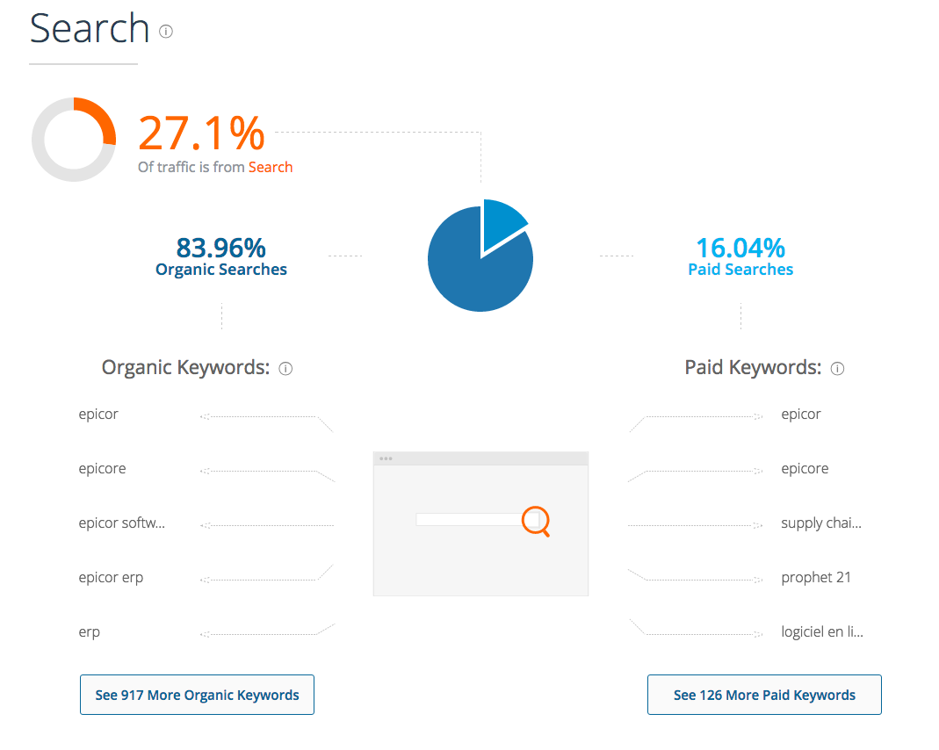
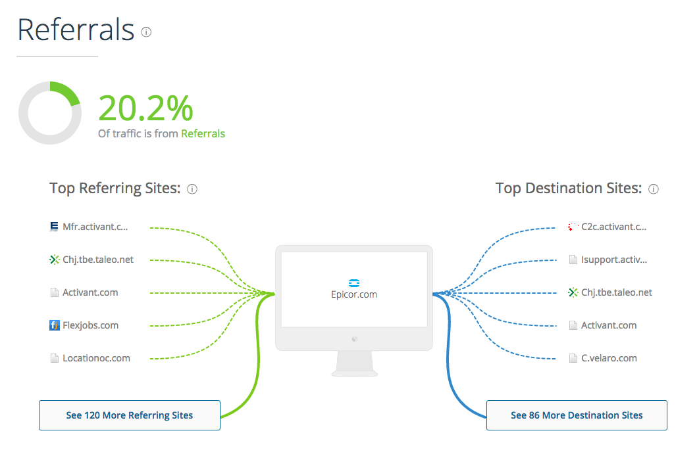
Data Example: SimilarWeb
http://www.similarweb.com/website/epicor.com
Web Savvy Marketing & iThemes Media LLC Copyright © 2015, All Rights Reserved

Slide 10
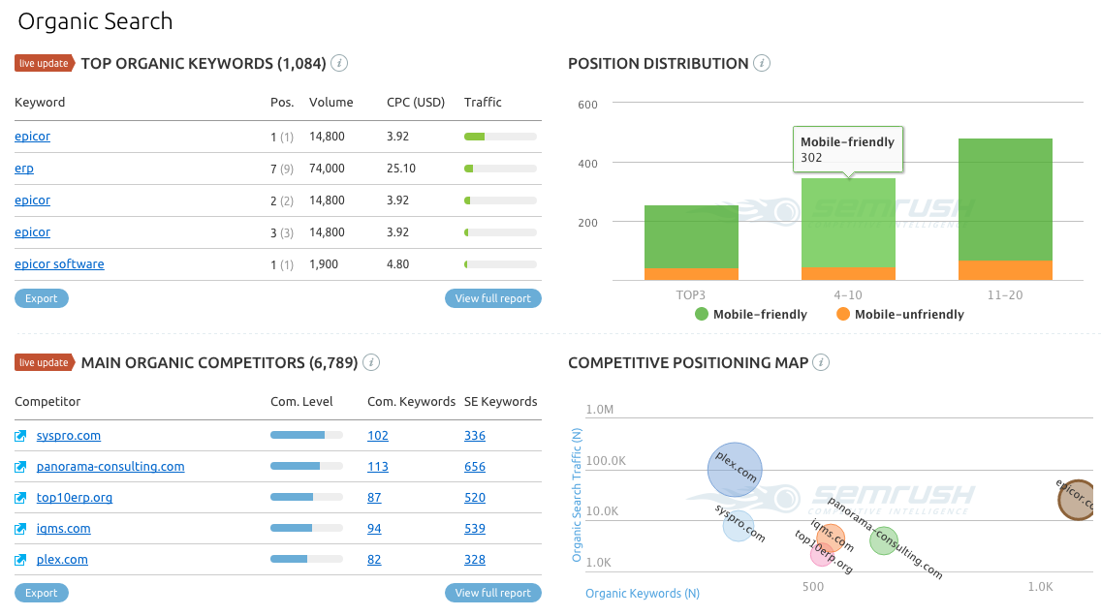
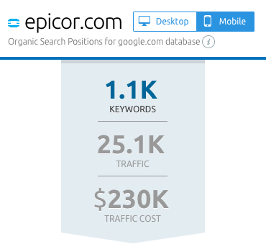
Data Example: semrush
http://www.semrush.com/mobile-us/info/www.epicor.com%2F
Web Savvy Marketing & iThemes Media LLC Copyright © 2015, All Rights Reserved

Slide 11
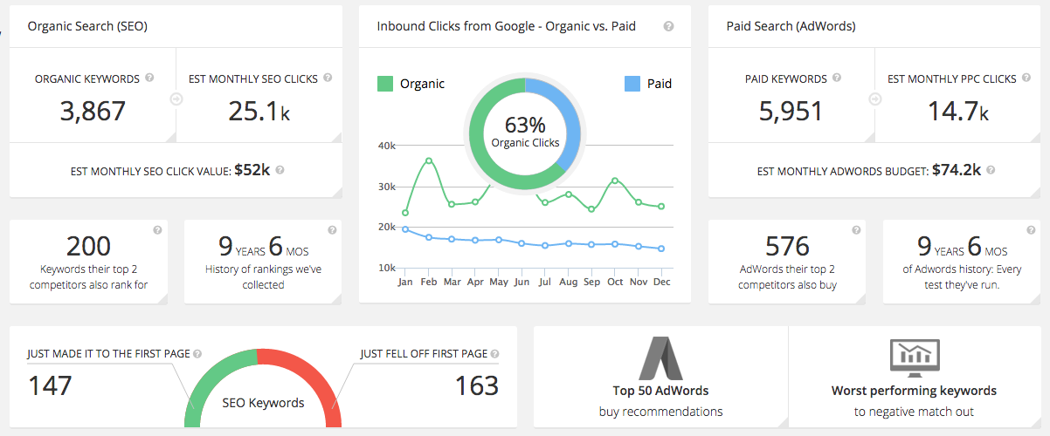
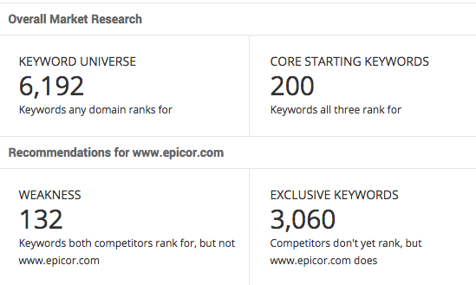
Data Example: SpyFu
http://www.spyfu.com/overview/domain?query=www.epicor.com
Web Savvy Marketing & iThemes Media LLC Copyright © 2015, All Rights Reserved

Slide 12
IN CASE YOU MISSED IT
Let’s take another look
at the core principles we
discussed on day one.
Web Savvy Marketing & iThemes Media LLC Copyright © 2015, All Rights Reserved

Slide 13
Remember the Formula
The Free SEO Tools are Used in the Entire Optimization Process
#1 –Research Keywords
#6 – Build Social Shares
Audit website, review competitors, research keywords and search volumes.
Share content on Facebook, Twitter, LinkedIn, and Google+.
#2 –Map Keywords to Content
#7 – Build Off-Site Authority
Map your preferred keywords to specific pieces of content within your website.
Get your main URL noticed and mentioned
via external sources to strengthen authority.
#3 – Write Content
#8 – Check Ranking Progress
Write content based on keywords, but stay focused on the user experience.
Give Google time to index and rank the content, then check on your progress.
#4 – Optimize Content
#9 – Optimize Further
Optimize URLs, headers, text, links, meta titles and descriptions for the keyword.
Fix what you missed. We all miss something
and we can always improve efforts.
#5 – Build Internal Links
#10 – Document and Repeat Success
Build internal links to the content via your navigation menu, footer, sidebar, content.
Document what ranked, reverse engineer why, and repeat process on other content.
Web Savvy Marketing & iThemes Media LLC Copyright © 2015, All Rights Reserved

Slide 14
Remember the Keys to Success
Research & Plan
Everything is based on research, data, and planning. Don’t write content until you research and explore possible keywords.
Create and Optimize
Create quality content that is closely tied to your target market and the data discovered with keyword research.
Strengthen Process
The process doesn’t end when content is published. Continue to optimize on and off-page as needed until desired results are obtained.
Web Savvy Marketing & iThemes Media LLC Copyright © 2015, All Rights Reserved

Slide 15
Boost Your Knowledge
1
SEO News Websites
Search Engine Land @ searchengineland.com
Search Engine Watch @ searchenginewatch.com
The Moz Blog @ moz.com/blog
Search Engine Round Table @ Seroundtable.com
2
SEO Reporters and Bloggers on Twitter
3
SEO Consultants on Twitter
@DannySullivan @MattMcGee
@rustybrick @MattCutts
@DuaneForrester @randfish
@sugarrae
@SEOAware
@AlanBleiweiss
@glenngabe
Web Savvy Marketing & iThemes Media LLC Copyright © 2015, All Rights Reserved

Slide 16





How Can We Help You?
Cory Miller
Rebecca Gill
@corymiller303
@rebeccagill
Web Savvy Marketing & iThemes Media LLC Copyright © 2015, All Rights Reserved

