Slide 1

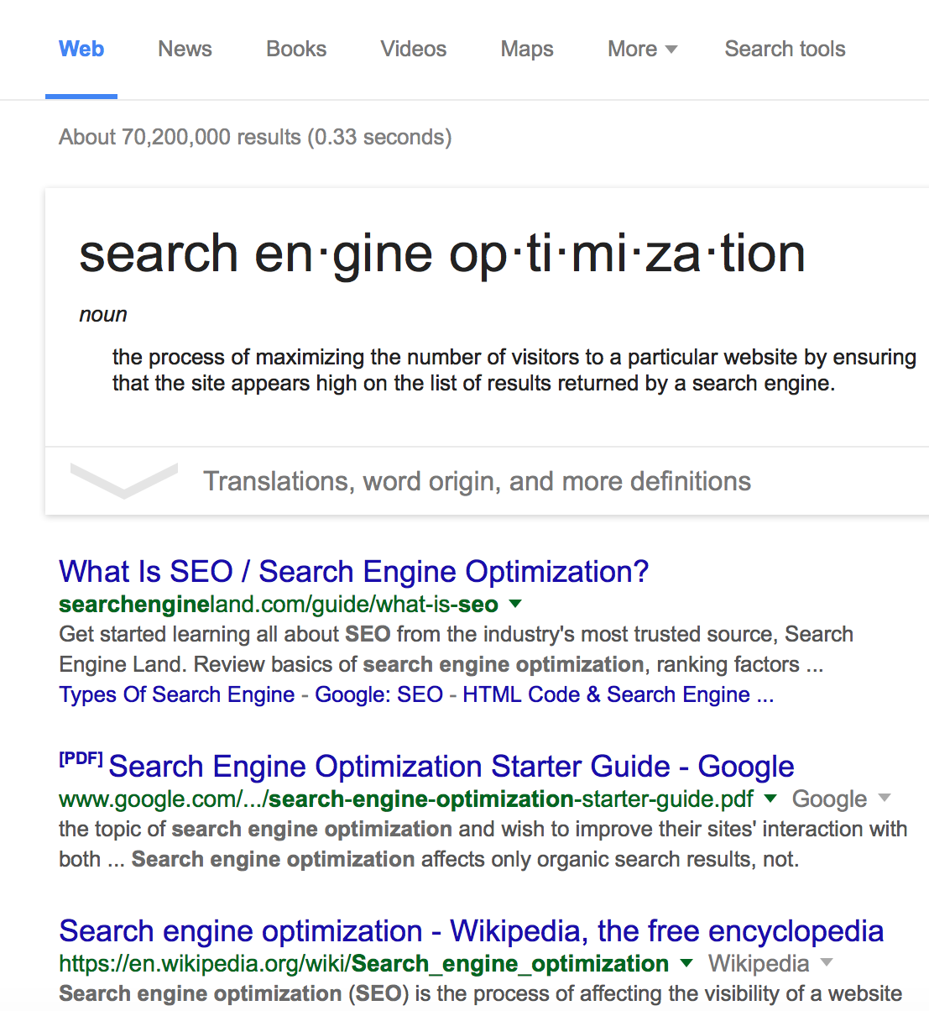
Day
ONE
Basics of SEO
Webinar Series
Avoid Common SEO
Mistakes and Challenges

Slide 2
MY SECRET SEO SAUCE
Is really just
one simple concept.

Slide 3
Think like Google
It really is THAT SIMPLE.

Slide 4
Revenue Generation
Never forget Google’s ultimate goal and use this to your advantage.
Google’s primary goal is to dominate internet search
so it can make money through pay per click advertising
and display ads. PPC activity depends on organic search
to drive users to Google. This requires…
$
Good Content
Website Pages, Blog Posts, Images, Videos
Happy Users
Organic Search and Paid Ads
Controlled Ranking
Control of Data to Protect the Experience

Slide 5
Focus on What Google
Really Wants and Needs
Quality Search Results
Your first opportunity to sell website visitors is before they EVER reach your website or blog. Meta matters to Google and users.
Clear Path to Relevant Content
Google needs webmasters and bloggers to create a very clear path to
the most relevant content for a given keyword or phrase.
High Quality Website Content
Write for real user. Think less about you, think more about your visitor, and write about what matters to them and not you.
Positive User Experience
If your visitors are happy with their experience in visiting your website via search, Google will be happy too. Happy Google means higher ranking.

Slide 6
DON’T BLAME GOOGLE
When your website or blog doesn’t rank.

Slide 7
Know What to Avoid
Know What Google Hates & Avoid it all All Costs
You don’t have to know all data points within Google’s algorithm or even changes to it.
You do need know some key basics to keep you safely focused on what really matters.
Lack of Keyword Focus
Crappy Content
Stagnant Websites
If you fail to focus on relevant topics, Google will fail to focus on your website or blog.
Thin, duplicate, or poorly written content will not attract Google or real users.
No one likes old content.
Freshness is important to the website and content itself.
Link Schemes
Poor Design & Code
Poor Performance
Just run away from “link juice” because it can very easily do more harm then good.
A bad UX is bad for SEO.
A quality WordPress theme is worth every penny spent.
Speed matters so optimize both desktop and mobile for performance and speed.

Slide 8
Winning at SEO Does NOT Require an Army of Resources
You just need create a positive user experience by adding key elements to content generation efforts.
Coding
Time
Social
Research
Design

Slide 9
REAL SEO SUCCESS
Requires strategy, planning, execution, and follow up.

Slide 10
SEO Formula
Ten Years of SEO With the Same Basic Ten Point System
#1 –Research Keywords
#6 – Build Social Shares
Audit website, review competitors, research keywords and search volumes.
Share content on Facebook, Twitter, LinkedIn, and Google+.
#2 –Map Keywords to Content
#7 – Build Off-Site Authority
Map your preferred keywords to specific pieces of content within your website.
Get your main URL noticed and mentioned
via external sources to strengthen authority.
#3 – Write Content
#8 – Check Ranking Progress
Write content based on keywords, but stay focused on the user experience.
Give Google time to index and rank the content, then check on your progress.
#4 – Optimize Content
#9 – Optimize Further
Optimize URLs, headers, text, links, meta titles and descriptions for the keyword.
Fix what you missed. We all miss something
and we can always improve efforts.
#5 – Build Internal Links
#10 – Document and Repeat Success
Build internal links to the content via your navigation menu, footer, sidebar, content.
Document what ranked, reverse engineer why, and repeat process on other content.

Slide 11
MOST COMMON REASON FOR FAILURE
People jump to step three and forget everything else.

Slide 12
Three Keys to Success
Research & Plan
Everything is based on research, data, and planning. Don’t write content until you research and explore possible keywords.
Create and Optimize
Create quality content that is closely tied to your target market and the data discovered with my keyword research.
Strengthen Process
The process doesn’t end when content is published. Continue to optimize on and off-page as needed until desired results are obtained.

Slide 13
Boost Your Knowledge
1
Google’s Search Engine Optimization Starter Guide
Free PDF that walks through the basis of SEO and what Google considers to be important.
http://www.google.com/webmasters/docs/search-engine-optimization-starter-guide.pdf
2
Google Webmaster Blog
3
Bing Webmaster Blog
You can also get great information on up to date changes, just by reading Google’s blog.
http://googlewebmastercentral.blogspot.com/
While Bing doesn’t post as often as Google, great information can be found here.
http://blogs.bing.com/webmaster

Slide 14





How Can We Help You?
Cory Miller
Rebecca Gill
@corymiller303
@rebeccagill

